Slide 1
REGULAR EXPRESSIONS
(ReGex)

Slide 2
What is it?!
What is Regex? | Regex Uses
Regular Expressions are a group of characters or symbols, which are used to find a specific pattern in text. | Form validation SQL queries NLP

Slide 3

Real Life Scenario
Tom’s job is to read through online reviews and contact customers who left a phone number on their customer’s review page.
Some reviews are long and draggy. Tom has no patients to read through several paragraphs to find phone numbers.
Example:
review = 'I have called the service desk 100 times and nobody replies to me. I need a conversation ASAP!! My number is 111-1234567! I expected better service!! Call back fast. Thanks. Have a great day.'
With regex, Tom could easily extract the phone numbers from the reviews

Slide 4
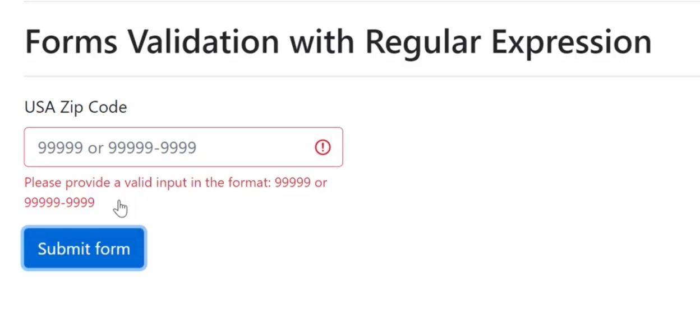
Forms Validation

Slide 5
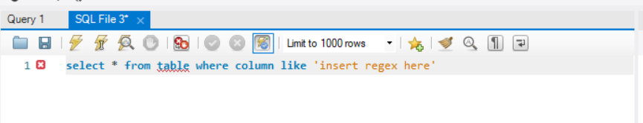
SQL Query

Slide 6

https://docs.python.org/3/library/re.html
Link to Documentation
Regex uses Python’s re module

Slide 7
Methods
Sets
Ranges
Quantifiers

Slide 8
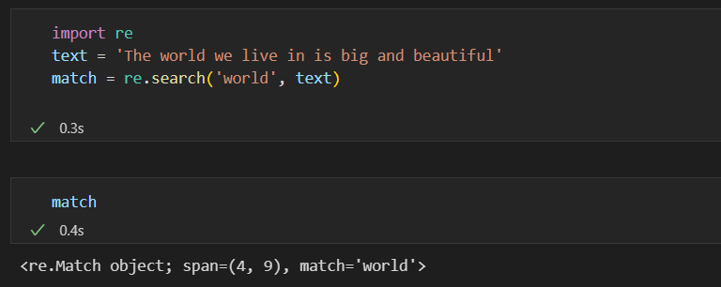
Methods Example of a method
re.search()
Find match anywhere in the text string. Returns the first match found in the statement. If a match is found, match object is returned.

Slide 9
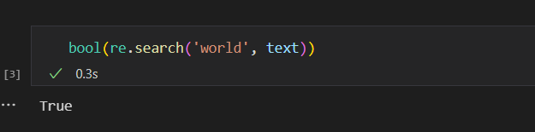

Slide 10
More Regex Methods
re.match() | re.findall() | re.span() | re.start() | re.end() | re.group()
Returns a match if found at the beginning of the string | Returns all instances of matches found in the string | Returns the position where the match is found in the statement Eg. (4, 12) | This method returns the start position of the match that was found in the statement. | This method returns the end position of the match that was found in the statement. | This method returns the word that is being matched with the pattern in the statement

Slide 11
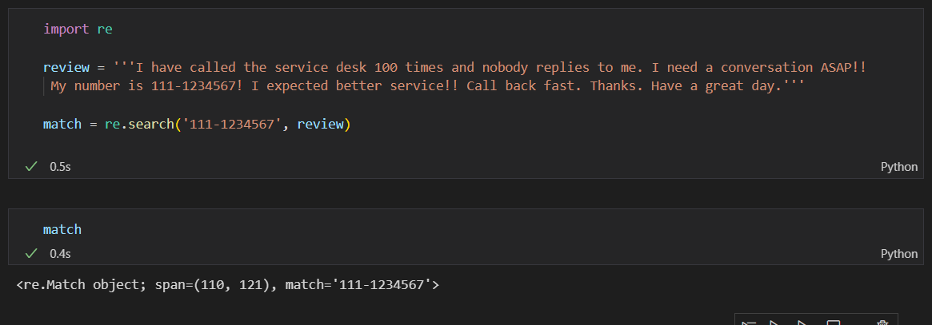
Back to Tom
How can he use regex to find the phone number?
review = 'I have called the service desk 100 times and nobody replies to me. I need a conversation ASAP!! My number is 111-1234567! I expected better service!! Call back fast. Thanks. Have a great day.'

Slide 12
BUT HOW CAN REGEX HELP TOM IF HE DOESN’T KNOW THE PHONE NUMBER?
Identifiers & Quantifiers

Slide 13
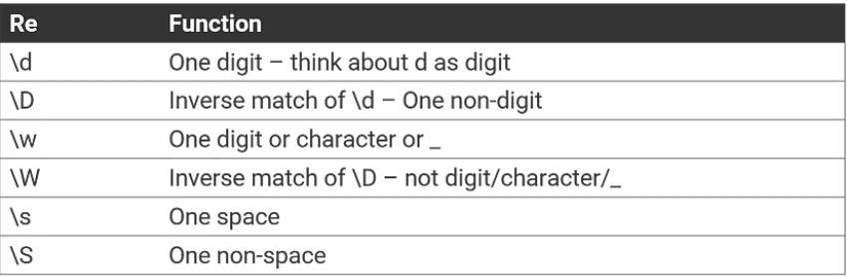
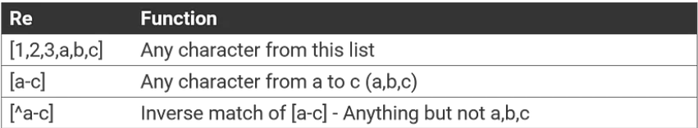
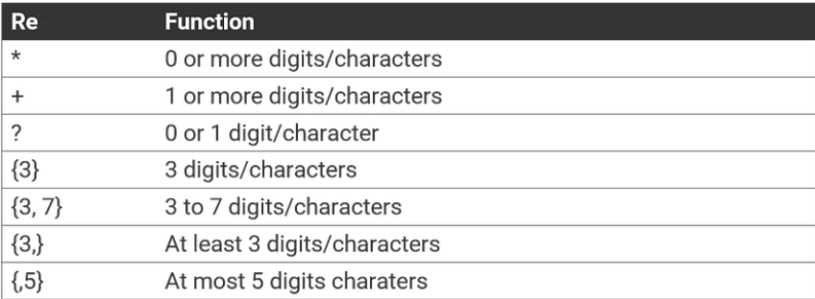
Sets, Ranges
&
Quantifiers

Slide 14
Sets, ranges & Quantifiers
EXAMPLES
match = re.search(r'[Ee]mail')
match = re.search(r'[A-Z]mail')
match = re.search(r'a{3,5}')
match = re.search(r'a*')
match = re.search(r'a+')
match = re.search(r'a?')

Slide 15
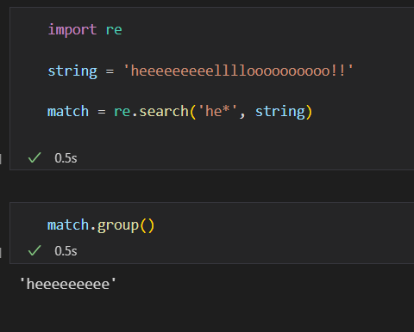
Sets, ranges & Quantifiers
EXAMPLES
match = re.search(r'[Ee]mail')
"Email", “email”
match = re.search(r'[A-Z]mail')
“Gmail”, “Email”
match = re.search(r'a{3,5}')
“aaa”, “aaaa”, “aaaaa”
match = re.search(r'a*')
0 or more occurrences of the pattern to its left
match = re.search(r'a+')
1 or more occurrences of the pattern to its left
match = re.search(r'a?')
0 or 1 occurrences of the pattern to its left

Slide 16
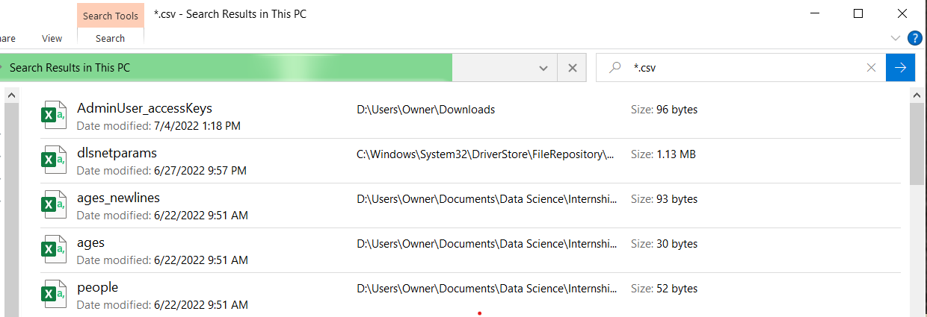
Quick Task
Try this in your file explorer:
Use regex to search for desired files

Slide 17
Anchors | Boundaries | Flags
^ (Caret) match the start of the string $ (Dollar) match the end of the string | \b boundary between word and non-word | -flags (params) Eg. Ignorecase re.search(pattern, string, re.IGNORECASE)
Anchors, Boundaries & Flags

Slide 18
Flags – re.I (ignore_case)
Write a regex that would find all the following versions of email:
E-mail
e-mail
eMail
E-Mail
EMAIL
emails

Slide 19
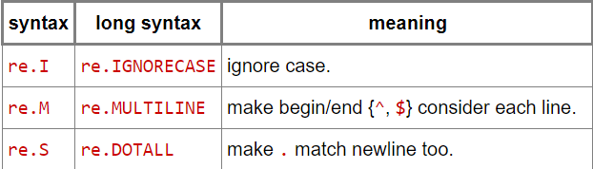
Some More Flags

Slide 20
Escape Characters
To match a character having special meaning in regex, you need to use a escape sequence prefix with a backslash ( \ ). ...
You also need to use regex \\ to match "\" (back-slash).
EXAMPLE:
To match [PDF] surrounded by brackets:
Pattern = r’\[PDF\]
Otherwise regex will see it as a set [PDF] and look for a P, D or F

Slide 21
Easy Practice
Let’s write a regex to match and three letter word

Slide 22
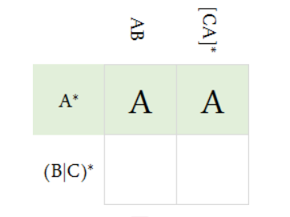
Fun Review☺
Regex Sudoku Puzzle

Slide 23
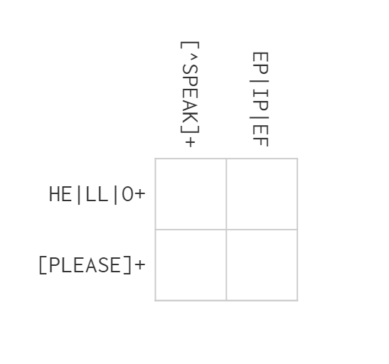
Fun Review☺
Regex Sudoku Puzzle
1

Slide 24
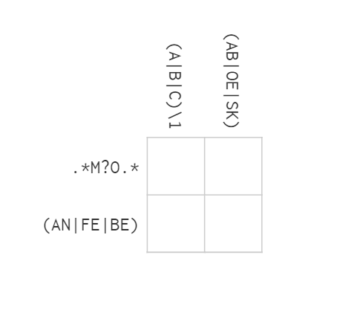
Fun Review☺
Regex Sudoku Puzzle
2

Slide 25
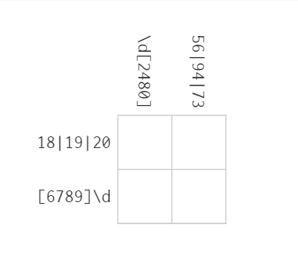
Fun Review☺
Regex Sudoku Puzzle
3

Slide 26
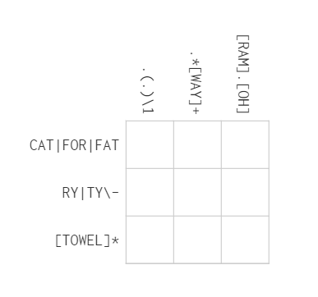
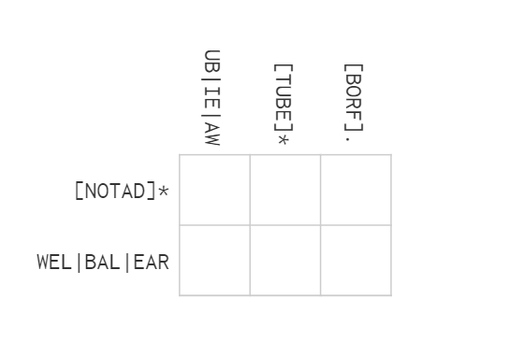
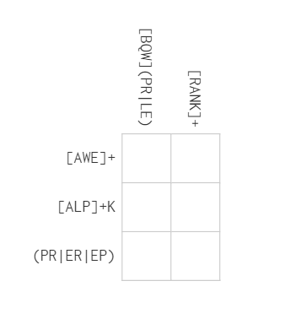
Fun Review☺
5
Regex Sudoku Puzzle
4
6

Slide 27
Capture Groups
When you only want to capture a specific string inside the pattern you put it inside a capture group and allows for you to return it
You create a capture group by putting parenthesis around the pattern you want to capture
Capture groups can also be useful to extract specific data from within our expression.
(Group1) (Group2) \1\2
str = 'purple alice-b@google.com monkey dishwasher'
match = re.search(r'([\w.-]+)@([\w.-]+)', str)
if match:
print match.group() ## 'alice-b@google.com' (the whole match)
print match.group(1) ## 'alice-b' (the username, group 1)
print match.group(2) ## 'google.com' (the host, group 2)

Slide 28
Non-capturing Grouping
Backreferences
Referencing a group
The first group is used by writing \1 The second group is referenced by writing \2 (and so on)
(Group) (Group2) \1\2
(this)(is)\1\2 = thisisthisis
Parentheses (?: ):
You can group an expression and ensure that it is not captured by references. For example, below are two groups. However, the first group reference we denote with \1 actually indicates the second group, as the first is a non-capturing group.

Slide 29
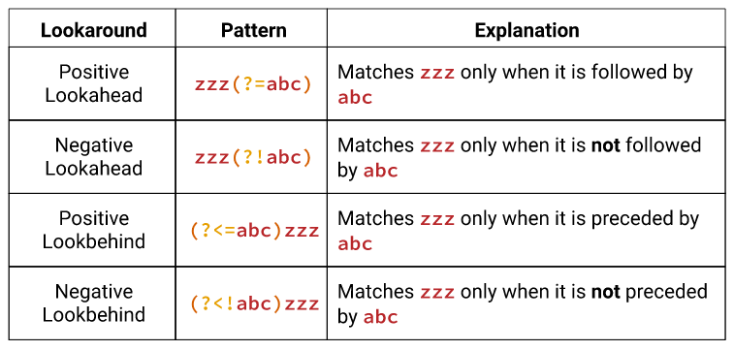
Lookarounds
Sometimes we want to find a pattern only if is found in a certain context, example, proceeded or followed by certain words or characters.
Lookarounds to the rescue!
These tips can help you remember the syntax for lookarounds:
Inside the parentheses, the first character of a lookaround is always ?
If the lookaround is a lookbehind, the next character will be <, which you can think of as an arrow head pointing behind the match.
The next character indicates whether the lookaround is positive (=) or negative (!).

Slide 30
Lookarounds
Lookaheads
wa(?=iter) only matches wa when followed by iter
wa(?!iter) not followed
Lookbehinds
(?<=iter)ate
(?<!=iter)ate- matches ate when not preceded by iter

Slide 31
PYTHONS REGEX LIBRARY VS. REGEX IN PANDAS
Clarification & Summary

Slide 32
Regex in Python Vs. Regex in Pandas
When do I use regex in python and when in pandas
Python’s re. module | Pandas
When accessing information from strings, docs, txt files etc. | When accessing information from a pandas dataframe.

Slide 33
Regex in Python Vs. Regex in Pandas
What Stays the Same?
In one line: The way we write the pattern stays the same.
In other words, the identifiers, quantifiers, ranges, sets etc. apply across the board. They way you write the pattern to be matched or found is the same in most languages.

Slide 34
Regex in Python Vs. Regex in Pandas
What Changes?
In one line: The method we use to find the regex in our text.
Python & Pandas Equivalents
Python’s re. module | Pandas
bool(re.search) | series.str.contains() (To see if a specific pattern appears in a series. The result was a series containing True, False, and missing values)
re.search() | series.str.extract() (To extract a pattern of characters from a column as a dataframe. Will only extract the first match of the pattern)
re.findall() | series.str.extractall() (To extract a pattern of characters from a column as a dataframe. Will only extract the first match of the pattern.)
re.sub() | series.str.replace()

Slide 35
Series.str.
series.str.contains() | series.str.extract() | series.str.extractall()
Syntax: Series.str.contains(pat, case=True, flags=0, na=nan, regex=True) Parameters : pat : Character sequence or regular expression. case : If True, case sensitive. flags : Flags to pass through to the re module, e.g. re.IGNORECASE. na : Fill value for missing values. regex : If True, assumes the pat is a regular expression. Returns : Series or Index of Boolean values | Syntax: Series.str.extract(pat, flags=0, expand=True) Parameters : pat : Regular expression pattern with capturing groups. flags : int, default 0 (no flags) expand : If True, return DataFrame with one column per capture group. Returns : DataFrame or Series or Index | Same as extract(), but extracts all match instances as apposed to extract() which extracts only the first match.

Slide 36
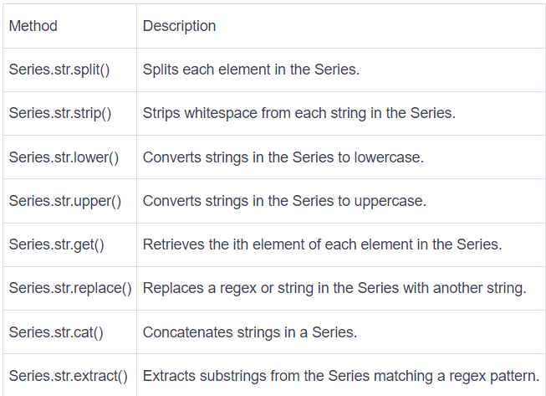
Reminder:
Some more common vectorized string methods

